Slide 1

PROJECT JAVA
BOULDER DASH
Group 4
ATANGANA ERIC – DASSI MANUEL – FOUDA LESLIE – MASSODA BORIS
SUPERVISING BY Me Junie

Slide 2
INTRODUCTION
SOMMARY
PROJECT
PRESENTATION
STRUCTURING
AND PRODUCTION
SIMULATIONS
AND TESTS
CONCLUSION

Slide 3

PROJECT
PRESENTATION
01
02
03
Context
Problematique
Goals
04
05
Resources
Planning

Slide 4
Context
I
What is it about ?
We have to code it in JAVA and use Maven, which is a build automation tool used primarily for Java projects and a database to stock our different levels
II
What does it have ?
He is promoting the game and increase the capacity of students that we are
III
To whom he gives a service ?
Students of more peoples
IV
What is it effective on ?
It acts on students of university

Slide 5
Problematique
How to convey and set up
The boulder dash Game

Slide 6
Goals
Model your program using diagrams such as class diagrams, components
We also need to use Git Hub which is an online versioning system
Build automation tool used primarily for Java projects and a database to stock our different levels.
Code it in JAVA and use Maven the game

Slide 7





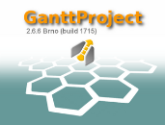

Software
Resources
JAVA EE 1.8
Visual
Paradigm
Eclipse IDE
Wampp server and Mysql
Git
Gantt Project

Slide 8

Hardware
Resources
Laptop

Slide 9
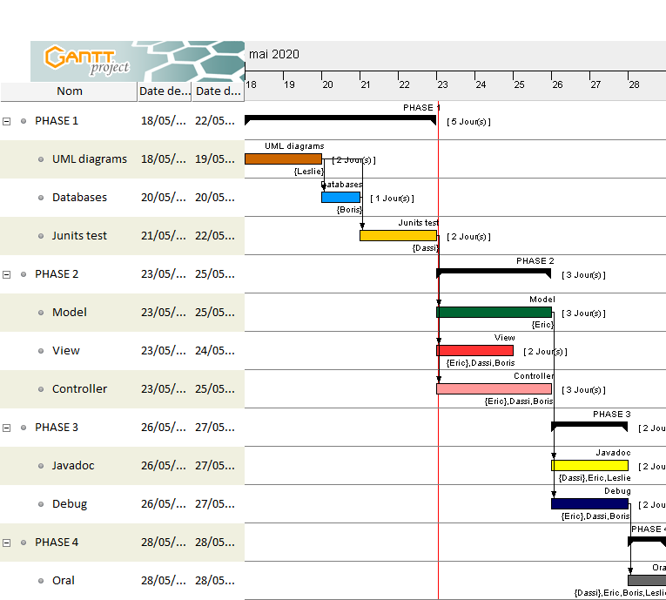
Provisional schedule

Slide 10
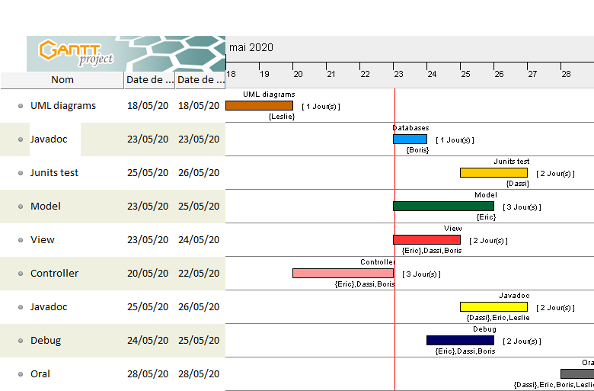
Real schedule

Slide 11
STRUCTURING
AND PRODUCTION
JAVA MODELLING
DATABASE MODELLING
PRODUCTION
DEBUGGING AND COMPILE

Slide 12
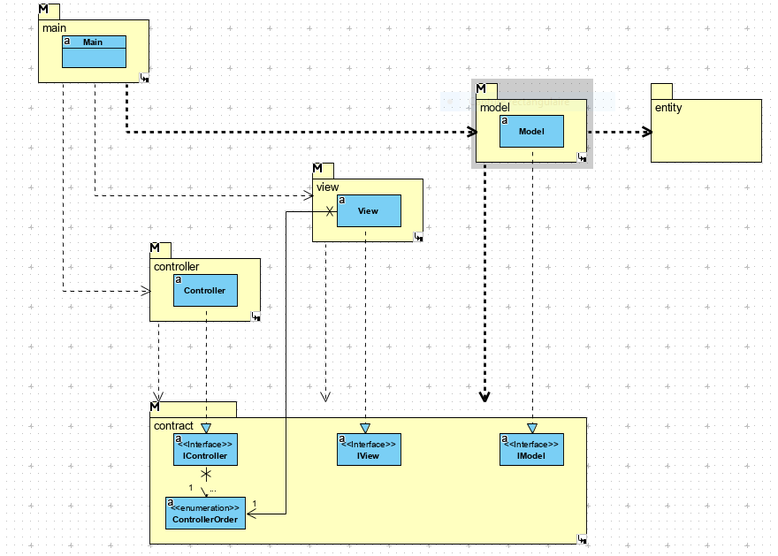
JAVA MODELLING
Diagram of Package

Slide 13
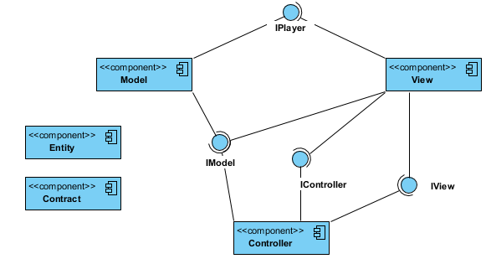
JAVA MODELLING
Component diagram

Slide 14
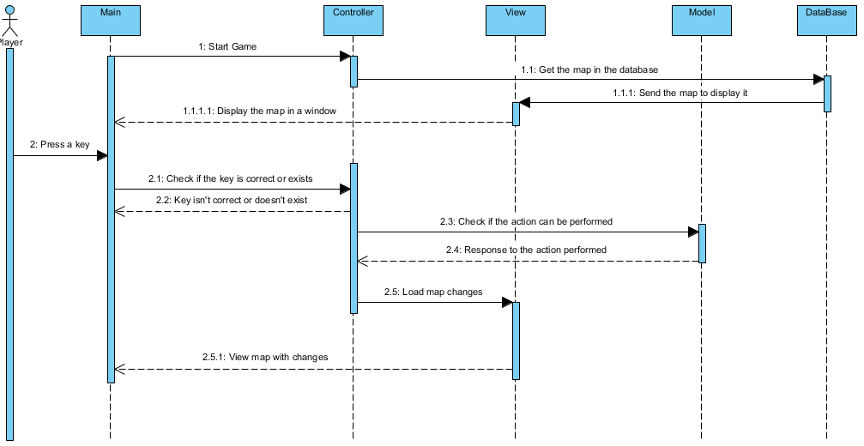
JAVA MODELLING
Sequence diagram

Slide 15
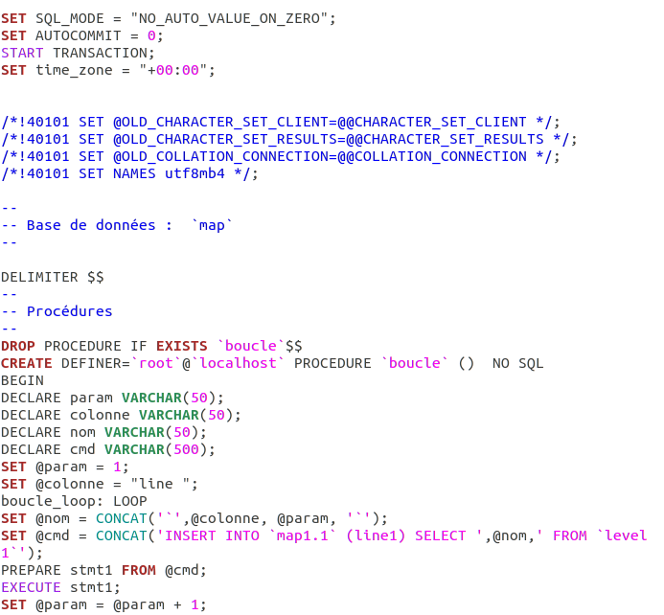
DATABASE MODELLING

Slide 16
PRODUCTION

Slide 17
PRODUCTION

Slide 18
PRODUCTION

Slide 19
PRODUCTION

Slide 20
PRODUCTION

Slide 21

THANKS

Slide 22
AVIS DES JURY

